Slide 16
Notes:
When we hear the Gospel read at Church
We make three crosses with our thumb
one on our forehead
one on our lips and
one on our heart
This is a sign that we want to
think about the words of Jesus
speak the words of Jesus and
love the words of Jesus
Do this together now

Slide 23
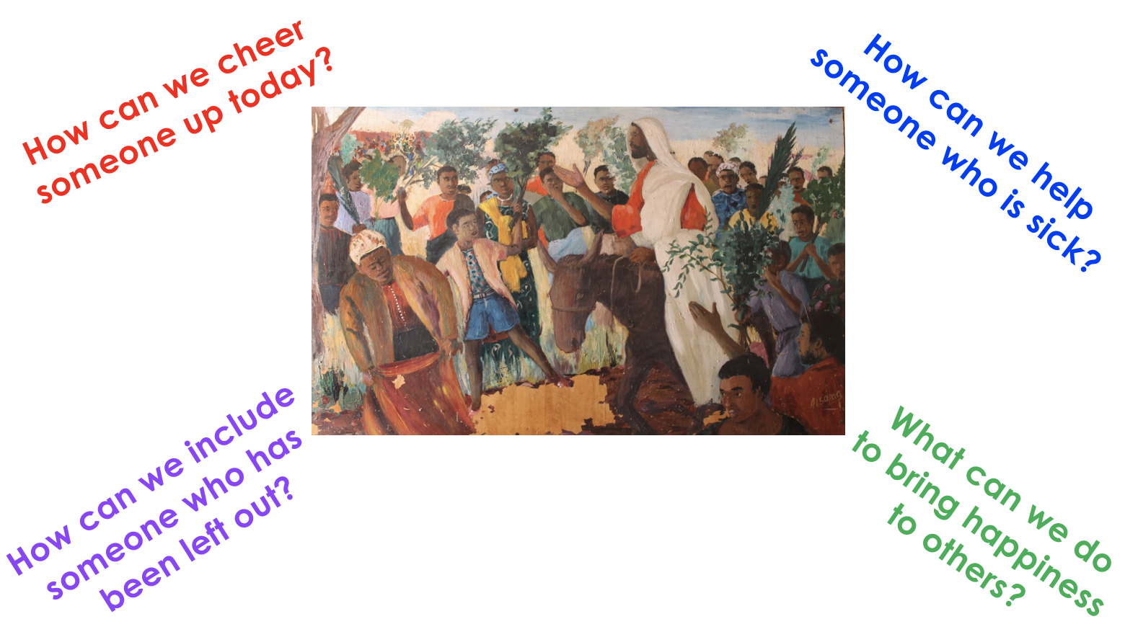

Slide 25
Would you like to make a palm cross
to welcome Jesus on Palm Sunday?
You could keep it as a reminder
of how much Jesus loved us
by dying on the cross of us.
Click on the link below
Palm Cross
Notes:
Make the sign of the cross to end your prayer

